Slide 1

Building an “In House” Billing Team
ABA Therapy Billing and Insurance Services
Presented by Michele Silcox

Slide 2
Insurance Billing and Collections Process
Timekeeping
Billing
Payment Posting
Collections and Appeals
Authorization
Eligibility

Slide 3
Eligibility and Authorizations

Slide 4

Defining Benefits
  Learn the difference between state regulated federal regulated and self-insured
    These will impact the benefit levels and authorizations to provide and be reimbursed for services
  Autism Law Summit
  Document benefit check (see example next slide)
  Cost shares will impact billing and collections
  Determine if there is primary and secondary insurance and what steps to take

Slide 5
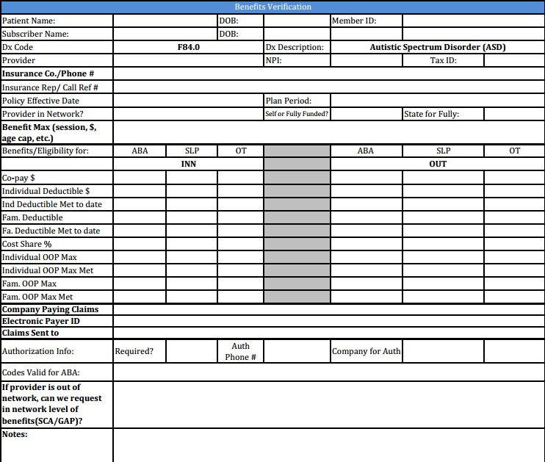
Example of Benefits Verification form.
Standard format to keep record of all eligibility and benefits calls.
Document all calls!

Slide 6
Basics of Authorizations
With new clients, best practice is to always wait until authorization is actually in place
For authorization renewals (every 6 months), start early so new authorization is in place before any lapse occurs
Have a way to track authorization expiration dates
Have a system for tracking utilization of the allowed hours
Check with families often about insurance changes

Slide 7
Timekeeping and Billing

Slide 8

Pros and Cons of Software
Mostly Pros!
Scheduling
  Ability to plan ahead and set schedules
  Scheduling can tie codes into each session for billing
Documentation of all sessions
  Set record of all staff services provided
  Easy to review and submit additional information to insurance
Fewer opportunities for errors
  Proper Unit rounding and rate calculations are automated
  Same data used for Payroll and Billing

Slide 9
When to Bill (Deadlines)
Time Cards
  If not using a scheduling software, have strict process for time cards
  Weekly deadlines for timekeeping; dealing with late time (it’s a billing nightmare!)
Scheduling
  Be sure staff are scheduled to fulfill authorizations correctly
  Even BCBAs should have schedules set in advance
Software: Definitely helps with time keeping and ability for electronic claims submission
Portal billing
Bill early and often
  Suggest weekly or bi-weekly

Slide 10
Codes and Units
Translating Codes into Services
  Set up on the front end with software or billing staff must “code” services
  Options: create tools to help staff crosswalk service descriptions (i.e. supervision, parent training) to the appropriate code
Units
  Important to have staff schedule appropriately based on units
  Examples: H2019 = 15 minutes, 0370T = untimed, 0364T = 30 minutes, H0032 = 1 hour
Rounding
  Always have staff record time according to what they actually do
  Rounding will occur on the “back end” through billers or software
  “Partial units” provided by staff will round up or down for billing

Slide 11
Payment Posting, Collections and Appeals

Slide 12

Understanding EOBs and Electronic Remits
First, have a way to record what you billed
Look for incorrectly paid claims
  Skipped claims
  Short payments
  Over payments
  Out of network processing
Becoming an expert at interpreting EOBs and incorrectly paid claims is critical to collections
  Saves time and energy to correctly problem solve your EOBs

Slide 13

Recording Payments
Payment Application
  Accurate payment tracking is critical
  Use your practice management software or carefully use Excel
Record patient responsibility so you can bill parents
  Parents are receiving EOBs as well, so there shouldn’t be surprises
  You cannot write of co-pays or coinsurance

Slide 14
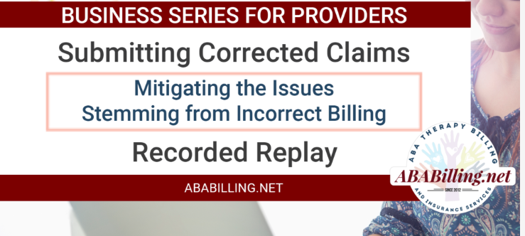
Submitting Corrected Claims
When is the right time and how do I do it?

Slide 15
Appeals and Disputes
Interpreting incorrectly paid EOBs is important
  Be sure to get to the “real” reason for incorrect EOBs
Simply sending claims back for reprocessing may not solve the problem
  May just delay payment further
Be ready to send appeals out – most of us wait too long!
  Include details of phone calls made to rectify the situation (Ref#, name, date)
  Parent involvement can expedite the process- get the clock ticking
Initial appeal (usually 30-60 days)
Secondary appeal (another 60+ days) last chance to add documentation
External appeal is your last appeal option
State DOI complaint

Slide 16
Managing your “In House” Billing

Slide 17
Be Involved
Get familiar with your state mandate and state laws
  Also know any state that you have policies for families where the home state is not your local
Get involved with Public Policy
  Autism Law Summit
Utilize Insurance Medical Directors, State Department of Insurance and a Healthcare Attorney when appropriate
  Be prepared to fight recoups and offsets

Slide 18
Set Guidelines and Metrics to Measure Success
Build the appropriate processes for each area
  Set clear guidelines and write the policies and procedures
Then Measure, Measure, Measure and look for areas of improvement to process or need for escalated action
  Don’t wait until it’s too late and you aren’t able to recover due to timely filing
  Don’t miss the low hanging fruit by avoiding the regular review of data

Slide 19
Don’t Sweat the Small Stuff!
Develop your metrics, measure your success but understand that Insurance billing and collections will have a percent that is not collected for a variety of reasons.
  Learn the difference between low hanging fruit that can be cleaned up and processes improved that over time will save money
  VS a one-off issue that can cost more to resolve with effort and resources the return on that cost

Slide 20
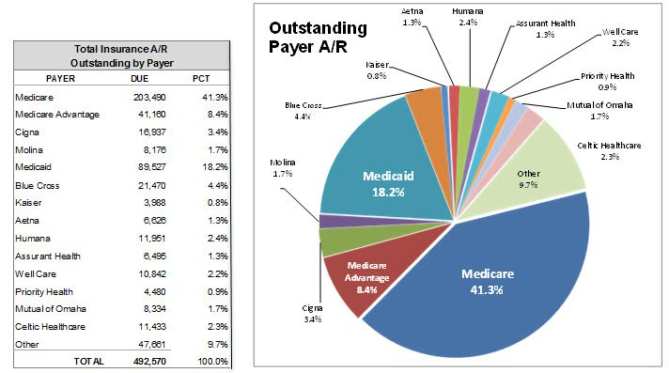
Reviewing Accounts Receivable
Run your Aging regularly!
  Keep the billing current and payments posted daily/weekly
  Have a clean cutoff for Year End
  With most software, this is a simple report
    Report should distinguish difference between Insurance A/R and Patient A/R
  Look for trends and issues from the big picture perspective as well as line by line
    Utilize Provider Reps for collections projects

Slide 21

Checks and Balances
Payment Posting is critical
  Are you using portals for remits?
  Do you have your deposits set as EFT?
  Do you tie out to what is deposited to your bank account?
  Are you adjusting from fee schedule to contracted amount during posting?
Evaluation of open claims with Portals
  Compare open dates of service with information you can see on the portal
  If something shows paid, research if you received check and applied

Slide 22
Patient Aging is part of your AR review
Parent Responsibility
  Are your payments posted properly to allocate parent responsibility?
  Are you sending out statements frequently?
    Do you have an easy method for parents to pay invoices (eg PayPal)
  Do you discuss patient responsibility up front with families?

Slide 23

Write Offs / Bad Debt Expense
Secondaries
  Have you determined the amount you can collect from Secondary insurance
Insurance Write Off
  Are there any true write offs / bad debt in your Insurance A/R?
  Questions to ask yourself
Patient Balance Write Off
  Seek legal counsel and research the laws in your state for financial hardship
Accounting Records
  Bad Debt is an expense – review with your Accountant
  Difference between Fee Schedule and Contracted Rate is not a bad debt expense

Slide 24

Resources and Questions
Contact Us: info@ababilling.net
  On Site Training/Auditing
Facebook Group: https://www.facebook.com/groups/ababillinginshelp/?fref=nf
Website: www.ababilling.net
  Check out our blogs for helpful info!

Slide 25
Next Webinar
June Webinar – Date to be Announced
Healthcare Insurance Fraud
Jodi Bouer
Bouer Law LLC
84 Hardy Dr.
Princeton, NJ 08540
T: 609-924-3990
www.bouerlaw.com

